Slide 1
COVID-19 Tracking Germany
https://www.kaggle.com/datasets/headsortails/covid19-tracking-germany

Slide 2
Background
Coronavirus disease (COVID-19) is an infectious disease caused by the SARS-CoV-2 virus.
The first known case was identified in China Wuhan at December 2019.
The disease quickly spread worldwide, resulting in the COVID-19 pandemic.
This dataset provides daily updated number of reported cases & deaths in Germany on state and county level from January 2020.
A dataset on vaccination progress from December 2020.
And a general state-level population demographics.

Slide 3
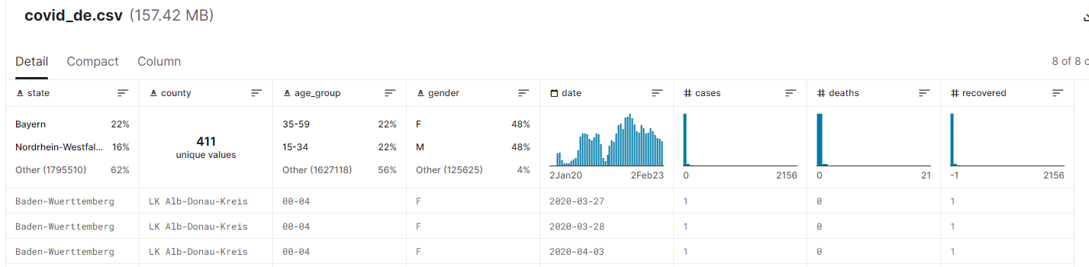
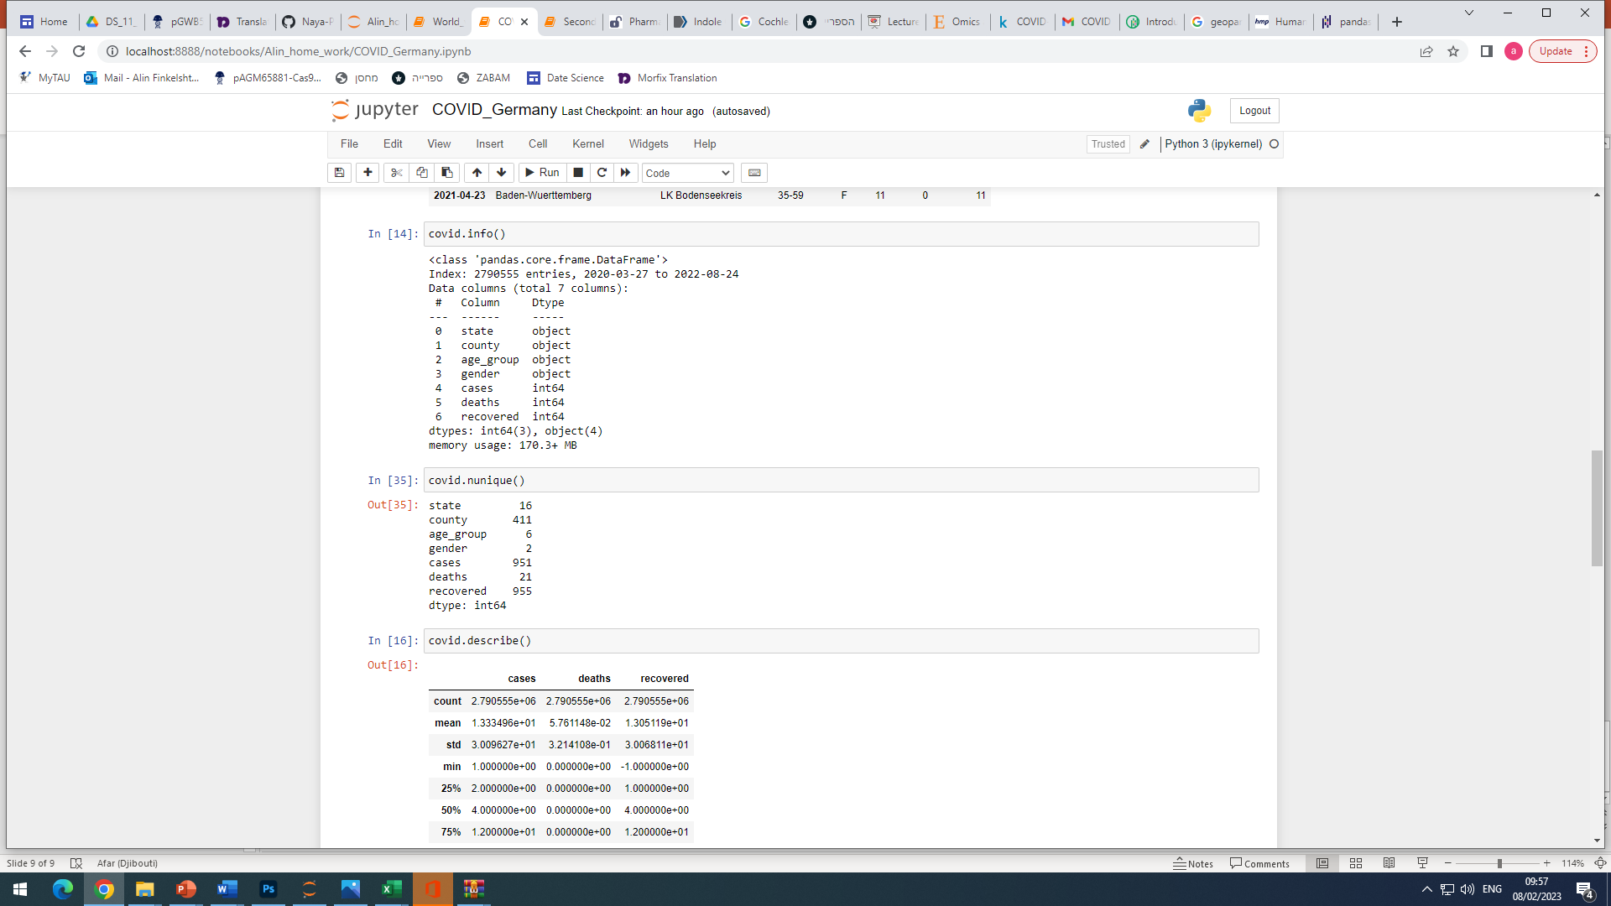
Dataset contains 3 tables:
covid_de.csv
Nunique
…………….

Slide 4
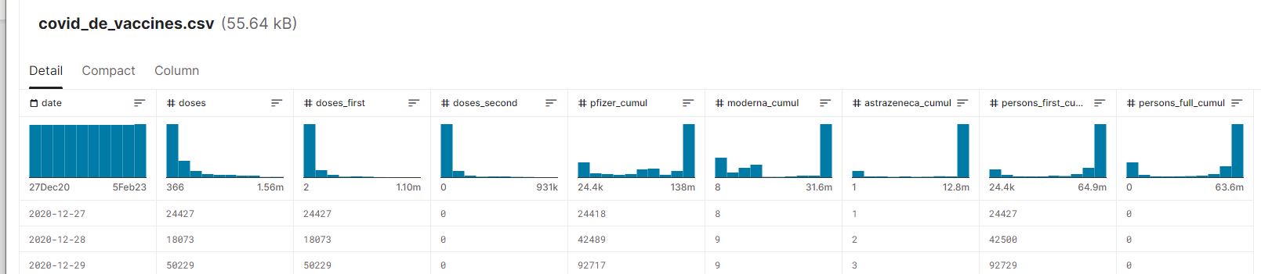
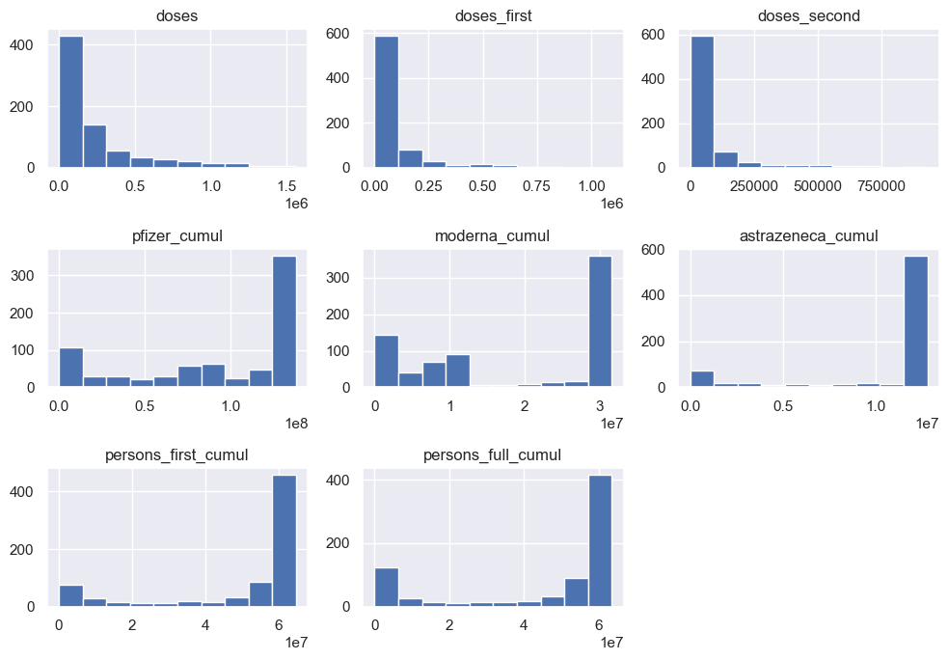
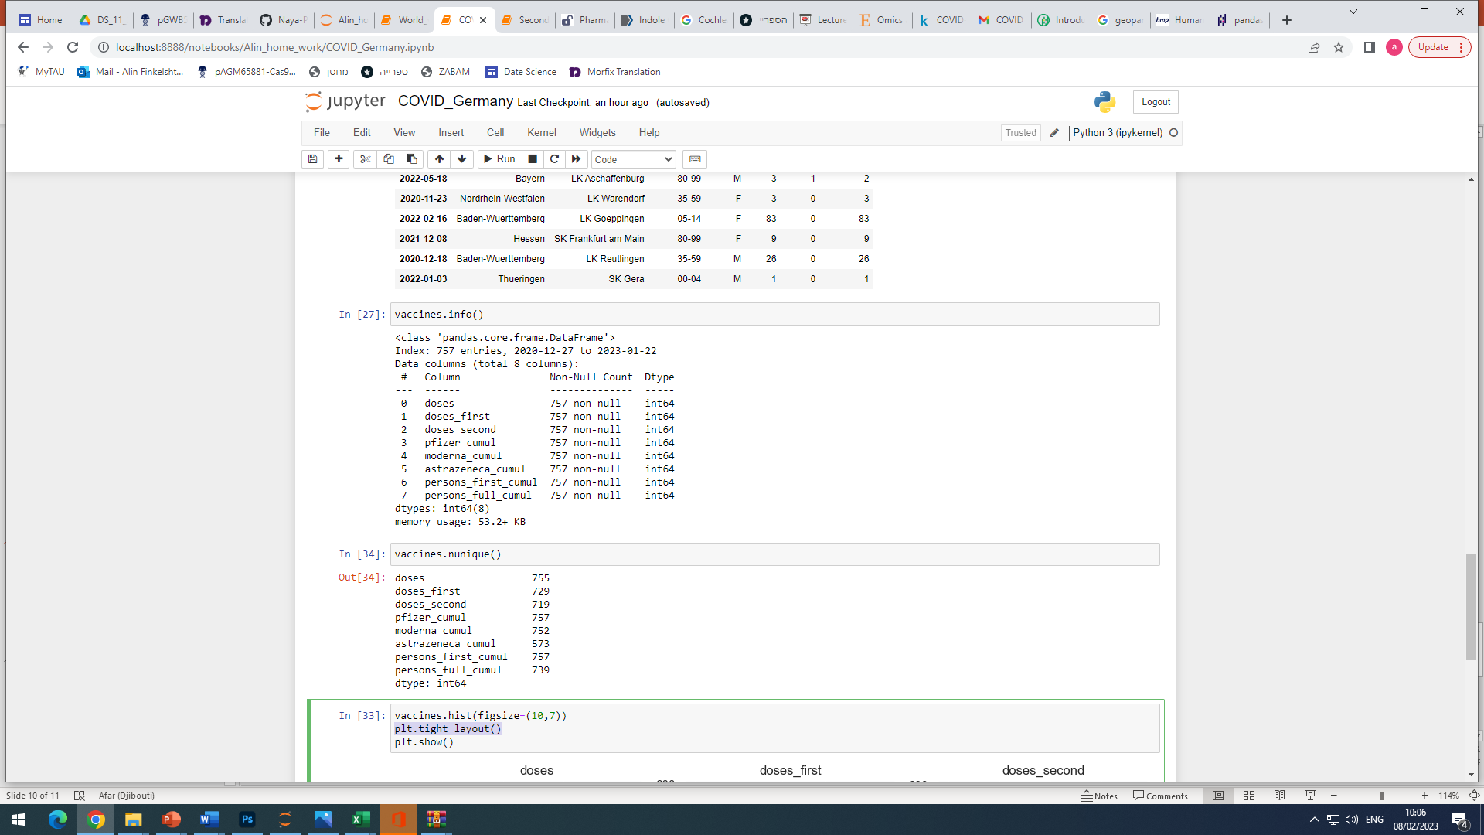
covid_de_vaccines.csv
Nunique
…………….

Slide 5
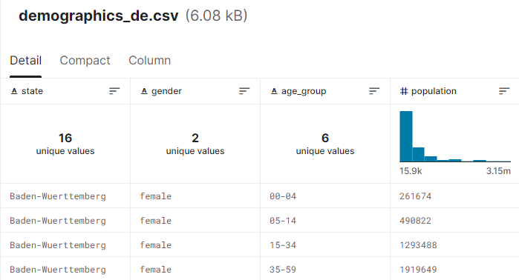
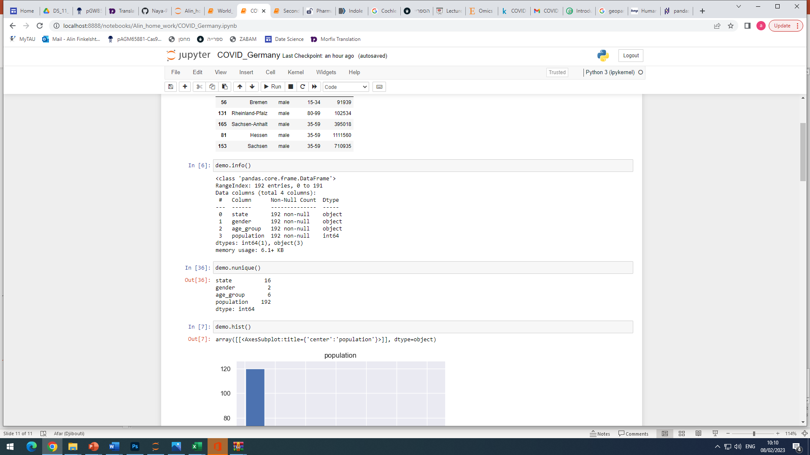
demographics_de.csv
Nunique
…………….

Slide 6
The main questions we can ask
Are there differences between genders in getting sick, recovery ratio, death ratio, vaccination patterns?
Are there differences in different age groups ( same parameters as above)?
Can we see differences in different regions of the country in the above parameters.
% of population fully vaccinated/partially vaccinated/not vaccinated in each region/county(visualization with GeoPandas)
Number of cases/ recovery/deaths in each region(visualization with GeoPandas)
Spread of vaccination manufacturer in each region (visualization with GeoPandas)
Are regions with younger population tend to vaccinate more /less vs older population regions?
Is there difference in vaccination pattern in different regions (quick response in the beginning/slow long response/late response e.c.t)?
Can we see a decrease in death following vaccination?
Are there differences between man and woman in vaccination patterns?

Slide 7
COVID-19 World Vaccination Progress
https://www.kaggle.com/datasets/gpreda/covid-world-vaccination-progress?select=country_vaccinations_by_manufacturer.csv

Slide 8
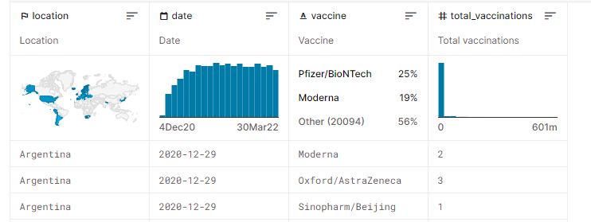
Basic information
The dataset contains 2 tables :
country_vaccinations_by_manufacturer.csv
 | Location | date | vaccines | Total vaccinations
ratio | worldwide | 4.12.20-30.3.22 | All manufacturer used in the country | Number of vaccinated per country
values | countries |  | Multiple categories
 | obj |  | obj | numerical

Slide 9
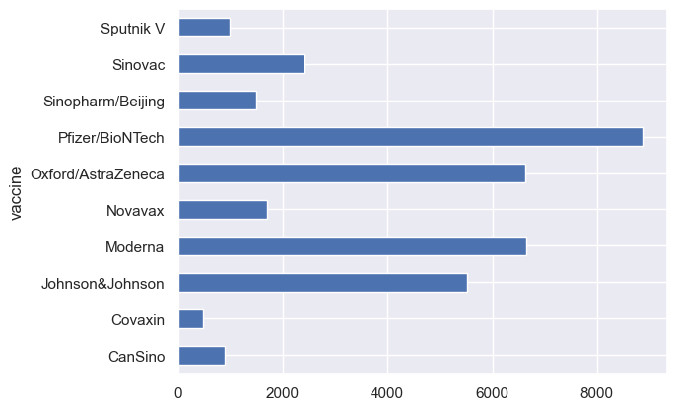
Number of vaccines/ manufacturer

Slide 10
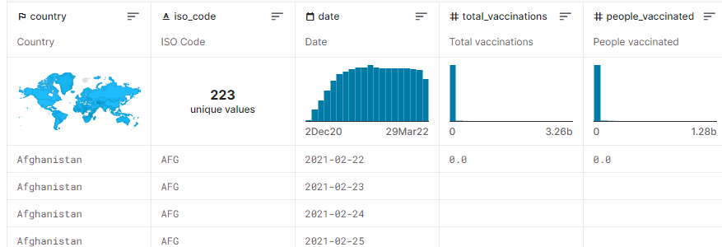
country_vaccinations.csv
Country- this is the country for which the vaccination information is provided;
Country ISO Code - ISO code for the country;
Date - date for the data entry; for some of the dates we have only the daily vaccinations, for others, only the (cumulative) total;
Total number of vaccinations - this is the absolute number of total immunizations in the country;
Total number of people vaccinated - a person, depending on the immunization scheme, will receive one or more (typically 2) vaccines; at a certain moment, the number of vaccination might be larger than the number of people;
Total number of people fully vaccinated - this is the number of people that received the entire set of immunization according to the immunization scheme (typically 2); at a certain moment in time, there might be a certain number of people that received one vaccine and another number (smaller) of people that received all vaccines in the scheme;
Daily vaccinations (raw) - for a certain data entry, the number of vaccination for that date/country;
Daily vaccinations - for a certain data entry, the number of vaccination for that date/country;
Total vaccinations per hundred - ratio (in percent) between vaccination number and total population up to the date in the country;
Total number of people vaccinated per hundred - ratio (in percent) between population immunized and total population up to the date in the country;
Total number of people fully vaccinated per hundred - ratio (in percent) between population fully immunized and total population up to the date in the country;
Number of vaccinations per day - number of daily vaccination for that day and country;
Daily vaccinations per million - ratio (in ppm) between vaccination number and total population for the current date in the country;
Vaccines used in the country - total number of vaccines used in the country (up to date);
Source name - source of the information (national authority, international organization, local organization etc.);
Source website - website of the source of information;

Slide 11
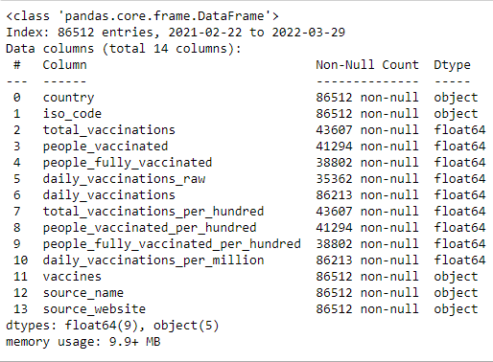
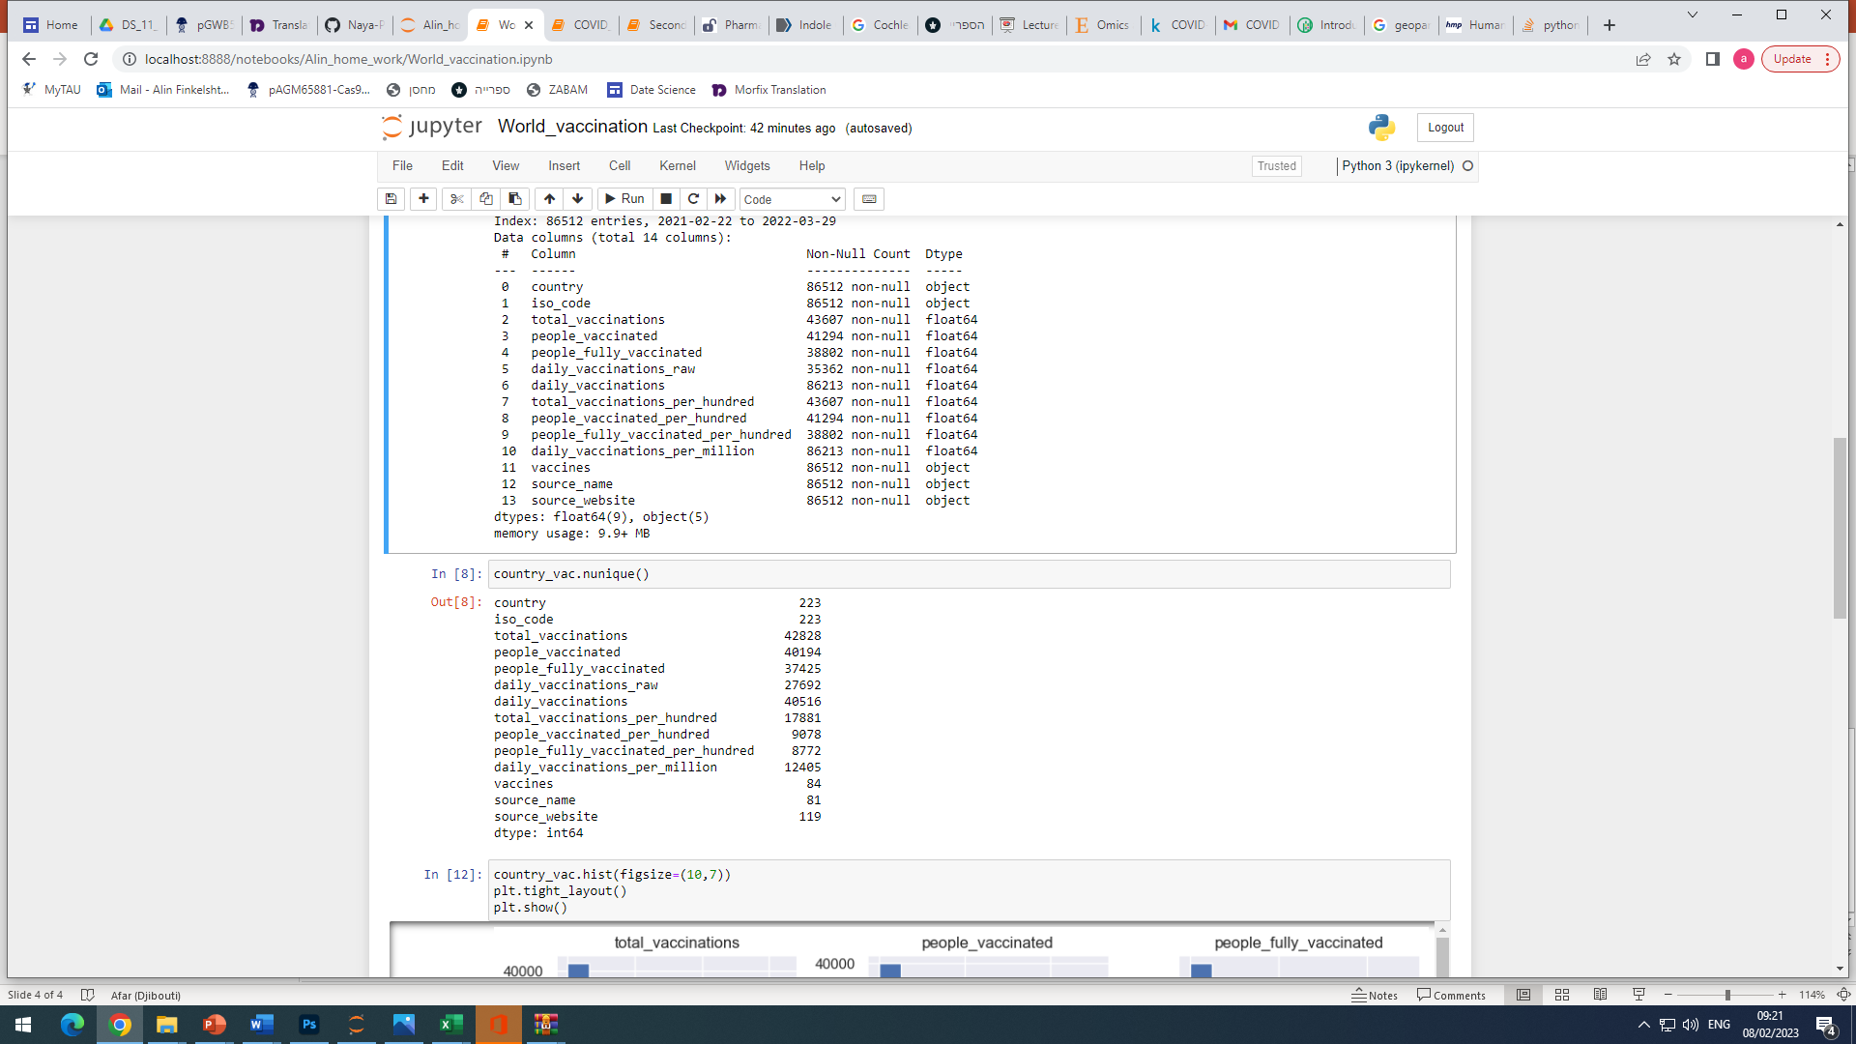
country_vaccinations.csv
Columns:
Nunique
…………….

Slide 12
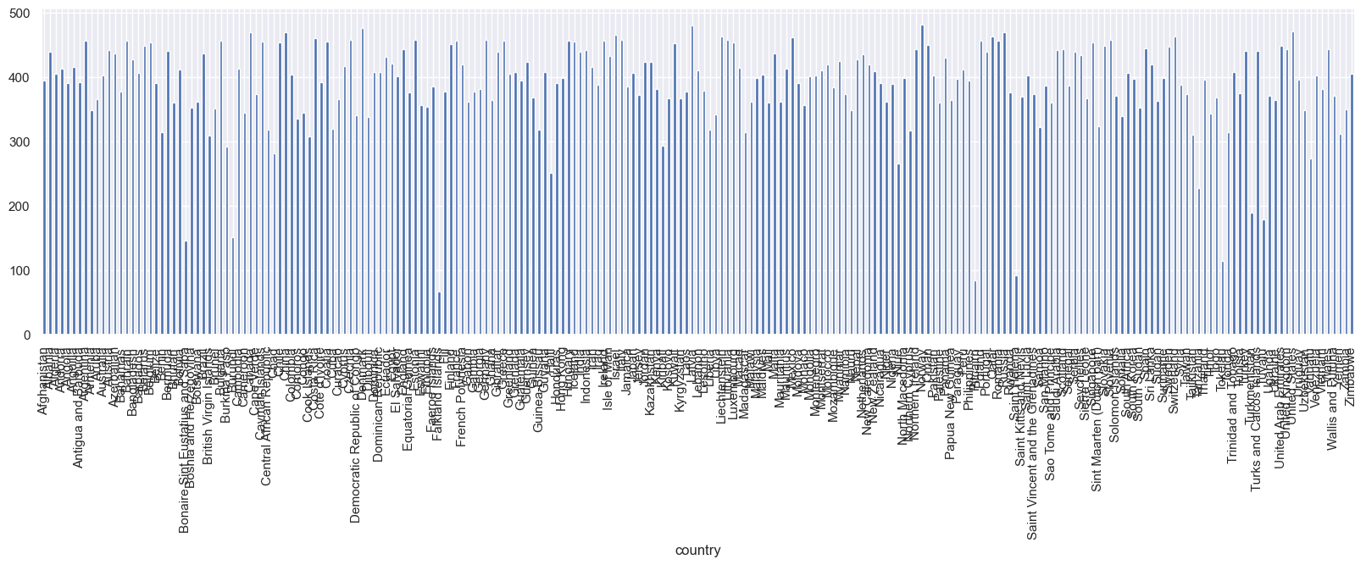
Total vaccinations/country

Slide 13
The main questions we can ask
% of population vaccinated in each country(visualization with GeoPandas)
% fully vaccinated vs partially vaccinated vs non vaccinated in each country
What is the main manufacturer in each country
What was the vaccination pattern(quick response in the beginning/slow long response/late response e.c.t)
Spread of each manufacturer in the world map(visualization with GeoPandas)
Group by regions like Europe, Middle east, Far east e.c.t. Is there a similar pattern of vaccination process in the region?

